Slide 1
SIGN IN!
OR IT DIDN’T HAPPEN…

Slide 2
DB2401 - SR353 Nolichucky Bridge Replacement, Washington County
Mandatory Pre-Proposal Meeting
Contractor
PRE-PROPOSAL MEETING
10/29/2024

Slide 3
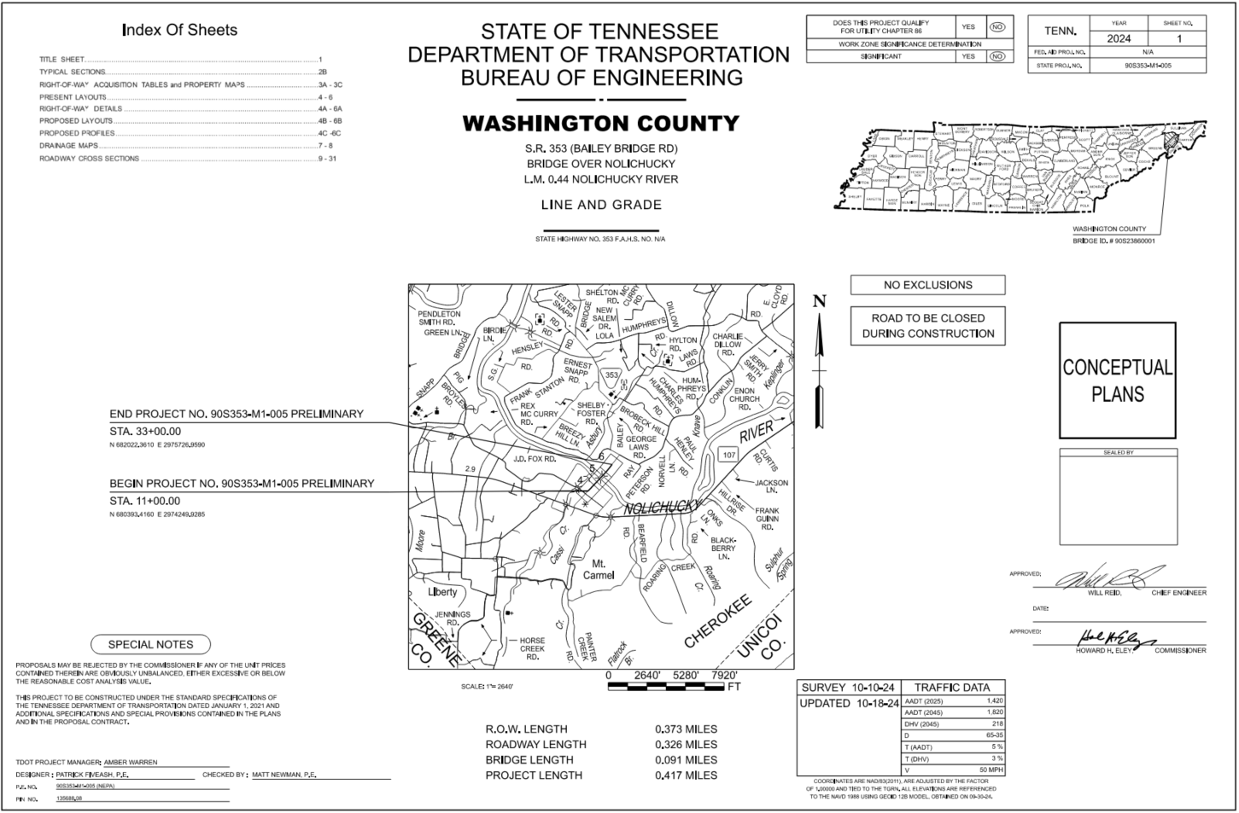
S.R. 353 NOLICHUCKY BRIDGE REPLACEMENT

Slide 4
Pre-Proposal Meeting Agenda
Contractor Sign-In
Welcome & Introductions
Design Build Process
Project Overview
RFP Information
TDOT Project Website
Questions
*Be sure to sign in*

Slide 5
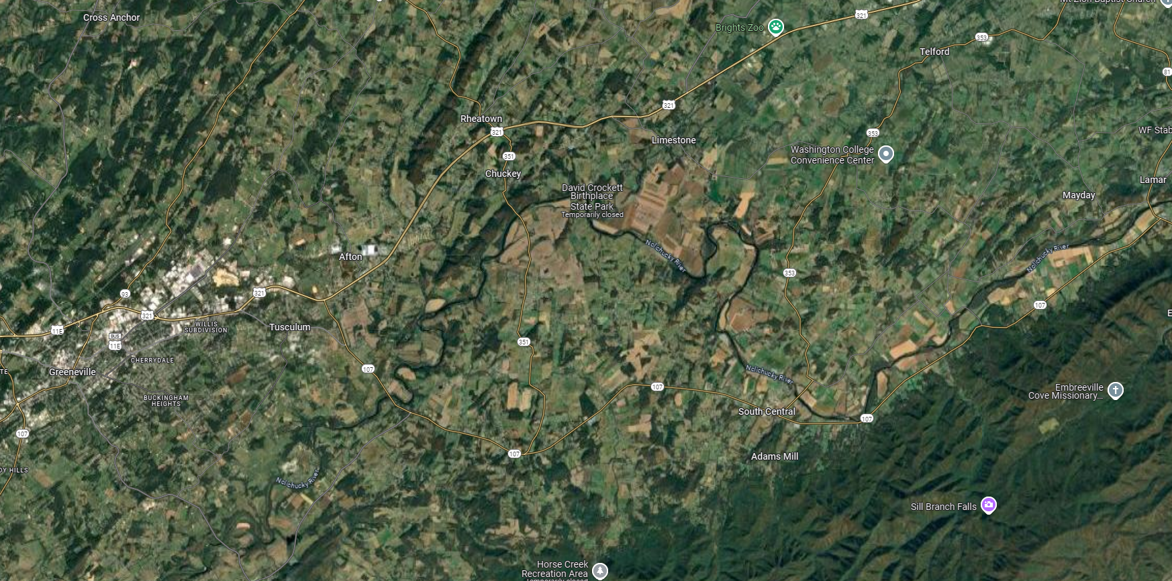
PROJECT LOCATION

Slide 6
TDOT Project Management Team
Amber Warren l Project Manager
amber.warren@tn.gov
Clayton Markham, P.E. l Director of Alternative Delivery
Clayton.Markham@tn.gov
Jason Sholtz, P.E. Region 1 Alternative Delivery Manager
865-594-3639 Jason.Sholtz@tn.gov
TDOT Project Team Functional/Support Areas: Construction, Design Engineering, Environmental, Geodetics, Geotechnical, ROW, Safety, Structures, Traffic Design, Utilities

Slide 7
Owners Rep Project Team
Jason Brady, P.E.| Project Executive
Jake Graves, P.E. | Senior Transportation Engineer
Diane Regensburg, P.E. | Project Coordinator
Mark Holloran, P.E. | Senior Transportation Engineer
Don McCrary, P.E. | Lead Structural Engineer
Patrick Fiveash, P.E. Project Manager
865-299-6130 Patrick.Fiveash@greshamsmith.com

Slide 8
Design Build
Design Build Defined
"Design-Build" means a project delivery method that combines all or some portions of the design and construction phases of a project - including without limitations design, right-of-way acquisition, regulatory permit approvals, utility relocation, and construction – into a single contract. TDOT will clearly define the standards and general specifications they expect for a project, and the design-builder works to satisfy those requirements.

Slide 9
Design Build Process
OWNER TDOT
Owner Rep
Contactor
Designer
Sub-Contractor

Slide 10
Design Build Process
Design Build Phase Contractor Responsibilities (not limited to)
Bridge, Roadway, Hydraulic, Geotechnical Design.
Environmental Compliance.
Construction in and around major waterway.
CPM Scheduling.

Slide 11
Draft Procurement Schedule
Schedule:
Event/Submittal | Date/Time
Mandatory Pre-Proposal Meeting – Region 1 Auditorium (7345 Region Lane Knoxville, TN 37914) | ​​10/29/2024​ ​1:00 pm​ EST
Advertising of RFP | ​​11/04/2024​
Deadline for submittal of Form QR, requests for QPL determination, organizational or Key Individual change requests, SOQ conflicts of interests update, and alternate technical concepts (ATCs) | ​​11/15/2024​ no later than 4:30 pm EST
Deadline for TDOT’s last response on Form QR, requests for QPL determination, organizational changes, SOQ resubmittals, and/or alternate technical concepts (ATCs) determination | ​​11/22/2024​
Deadline for issuance of last addendum | ​​11/26/2024​
Volume I (Cover Letter and Qualifications), Volume II (Technical Proposal and Appendices), Volume III, and Price Proposal Due Date | ​​12/10/2024 ​​no later than 10:00 am​ CST​
Notice of Best Evaluated Design-Builder | ​​12/13/2024​
Anticipated award of design-build contract (or rejection of all Proposals) | ​​On or before 12/20/2024​
Anticipated issuance of initial notice to proceed | ​​On or before 1/17/2025

Slide 12
Project Overview
Project Goals
Replace bridge destroyed in flooding from Hurricane Helena
Complete the project to meet functional objectives and outcomes while utilizing innovative solutions
Facilitate a collaborative partnership that minimizes known/established project risks and manages identified risks.
Complete the project as quickly as possible

Slide 13
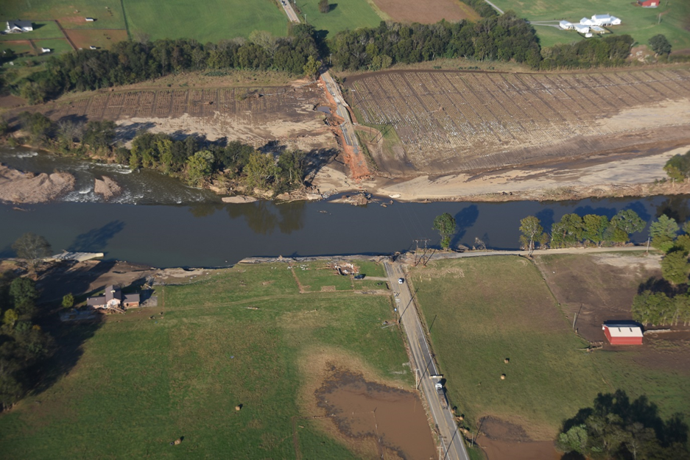
Project Overview
DB2401 - SR353 Nolichucky Bridge Replacement, Washington County
, Tennessee:
Replace bridge with proposed bridge approximately 500 feet in length.
Roadway approaches will be 2–11-foot travel lanes with 6-foot shoulders.
Design Speed of 50 mph.
Total project length approximately 2,300 feet.

Slide 14
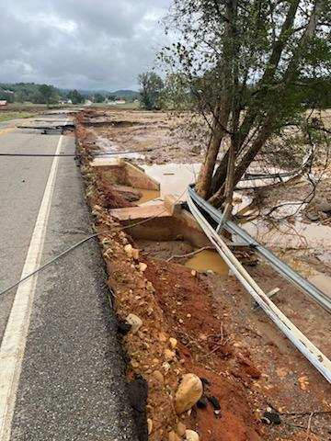
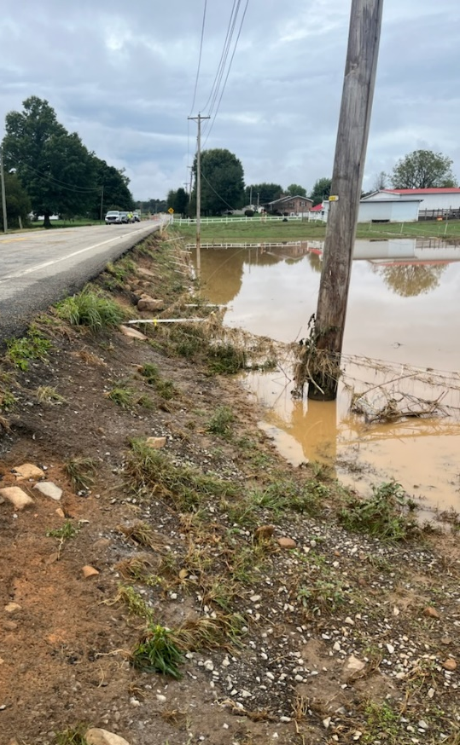
Project Overview
Investigation of 2-existing 4X4 Box culverts for replacement or extension.
Investigation of existing roadway bed for researching or full depth replacement.

Slide 15
Project Overview
Utilities:
Utility | Owner | Contact | Phone Number Email Address
Electric | Brightridge | Eric Rice | (423) 429-8109 erice@brightridge.com
Communications | Brightridge Fiber | Eric Rice | (423) 429-8109 erice@brightridge.com
Communications | Brightridge/CenturyLink | Andrew Ice | (423) 470-5636 andrew.f.ice@brightspeed.com
Communications | Comcast | Kevin Waldrop | (423) 791-4128 kevin_waldrop2@comcast.com
Water | Chuckey Utility District | Tyson Lamb | (423) 639-6362 tlamb@chuckeyutilitydistrict.com
Region 1 Utilities has made initial contact with owners.

Slide 16
Project Overview
Current Progress
NEPA – TDOT currently working on document.
ROW – TDOT will be performing all acquisition activities, including appraisals, appraisal reviews, and acquisitions, and any required utilities coordination/relocation as well as the acquisition of related permits
Design – Conceptual plans complete.

Slide 17
RFP Information
Tentative release date November 4, 2024.
Design-Build (TDOT WEBSITE)

Slide 18
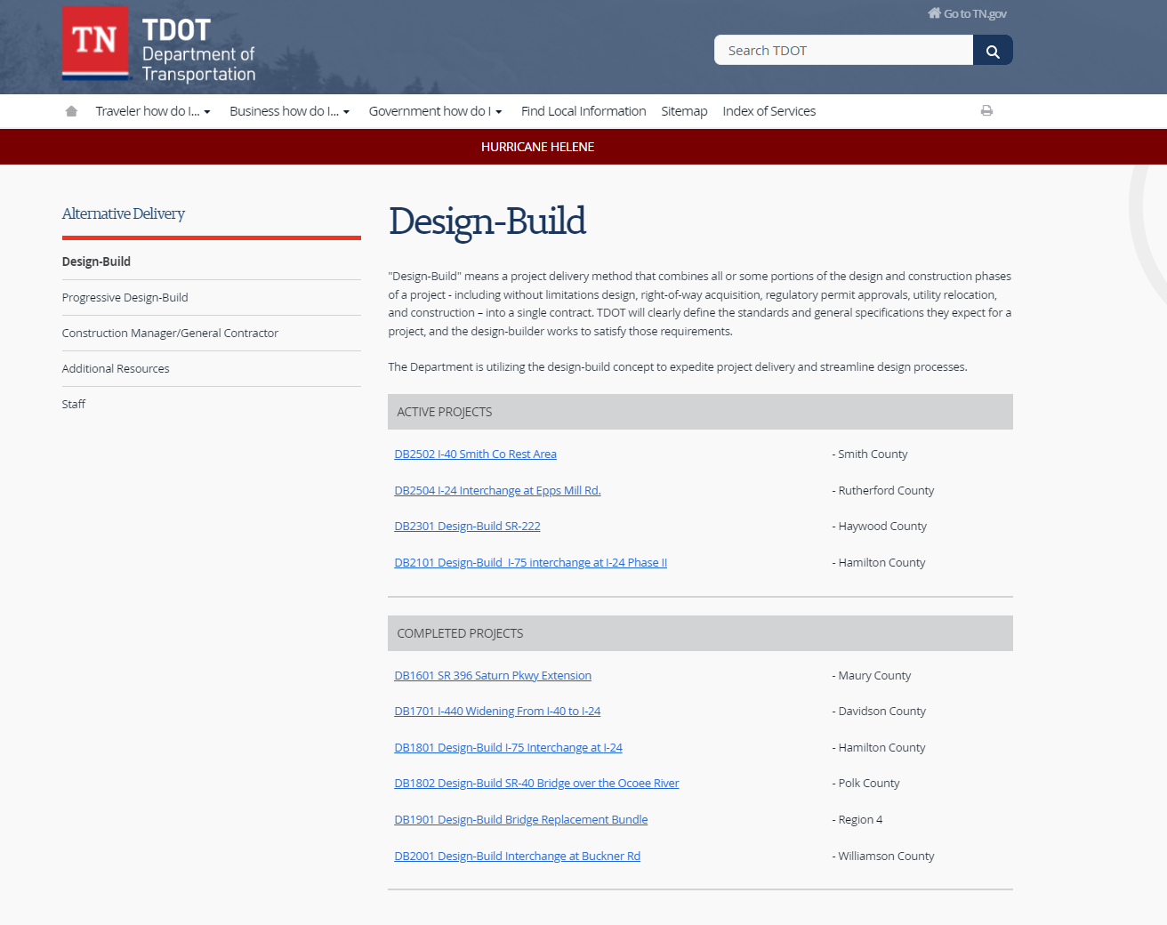
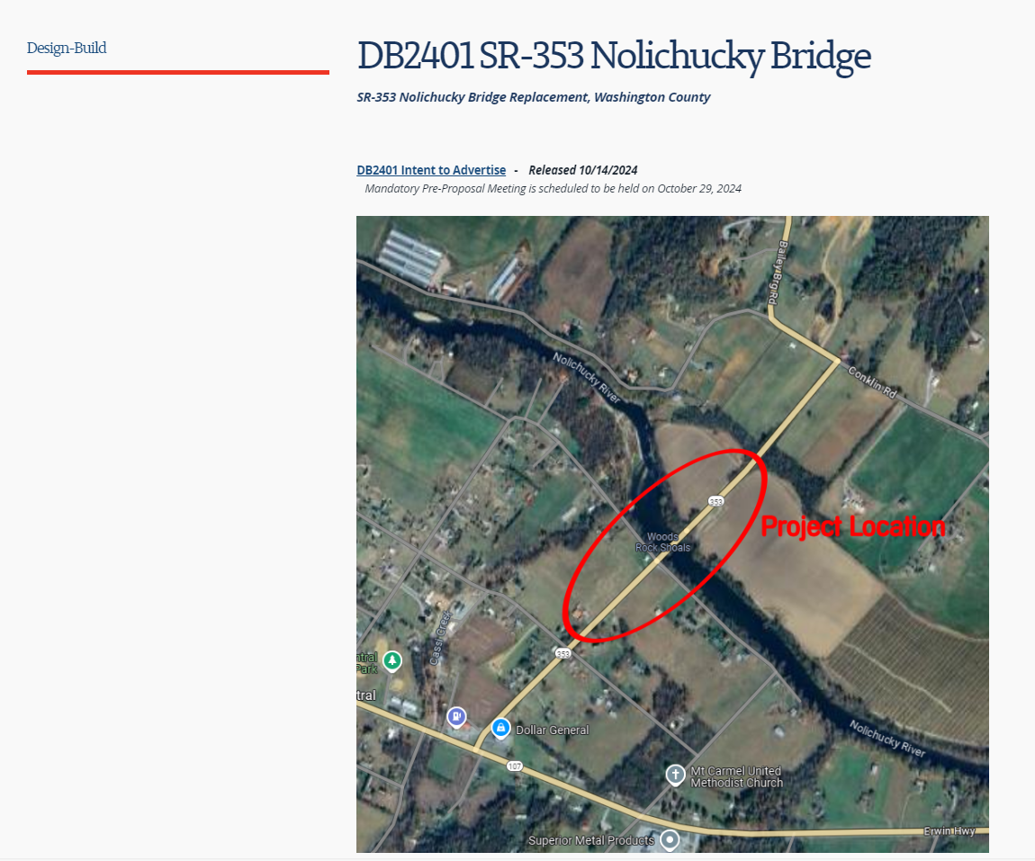
TDOT Project Website
PROJECT TO BE ADDED

Slide 19
Questions?

